Slide 1
Logical argumentation: preface
By Gayathri Peringod

Slide 2
Layout of this workshop
10 minutes: the case in plain terms and its listed arguments
50 minutes: round table discussion about argumentation

Slide 3
A day in the life

Slide 4
A day in the actual life

Slide 5
The case
R v Alex
Facts: Mr. Alex failed a road side test and failed a breathalyser at the station.
s. 258 of the CCC allows for breathalyser evidence to be entered without expert testimony
Alex argued that the officer didn’t have the right to take the breathalyser because he did not have reasonable grounds to believe Alex was impaired (drunk)

Slide 6
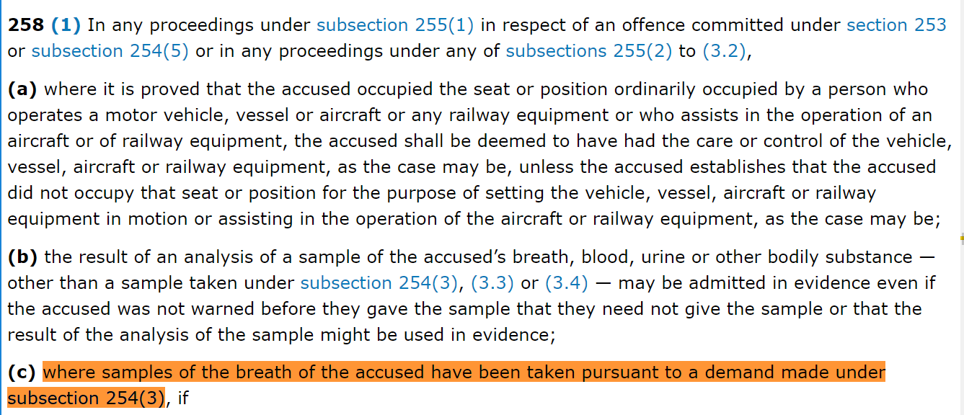
MAIN ARGUMENT against appeal
Who says evidence needs to be obtained lawfully?

Slide 7
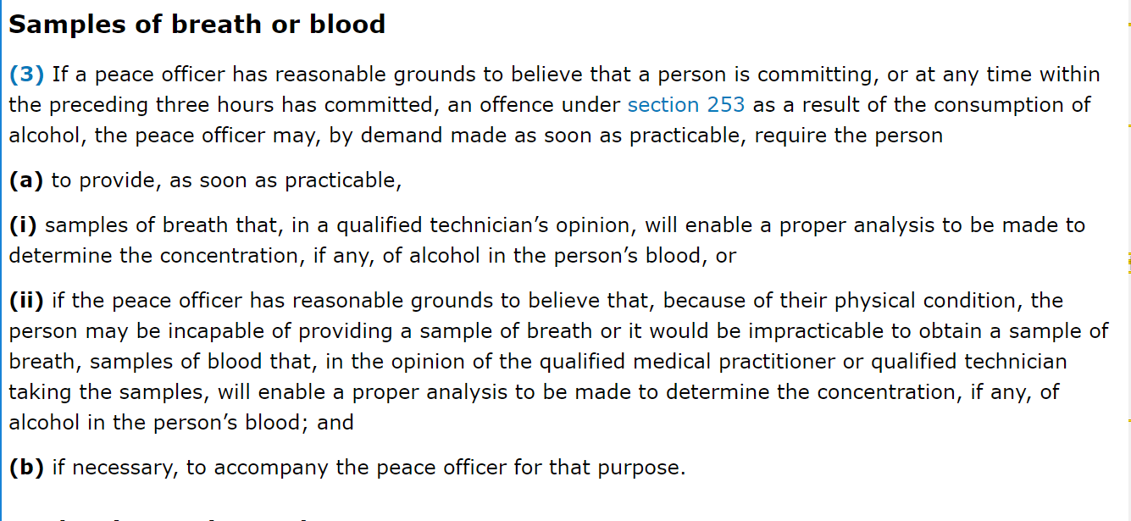
MAIN ARGUMENT against appeal
Who says evidence needs to be obtained lawfully?

Slide 8
Main argument for appeal
The police was not following the law when they obtained evidence

Slide 9
Key themes
Abuse of police power
Legality of obtained evidence
Overturning incorrect decisions
Inconvenience vs. proper carriage of justice

Slide 10
Point first
Start with your conclusion
Outline the arguments that support this conclusion
Makes these arguments
Re-state your conclusion
Notes:
You start with the conclusion, deconstruct it to each individual arguments leading up to the conclusion.

Slide 11
Order of operations
Appellant I: 7 minutes
Appellant II: 7 minutes
Respondent I: 7 minutes
Respondent II: 7 minutes
Appellant rebuttal (DO NOT USE)

Slide 12
About: Ucalgary moot court society
Workshops
September 26: Mooting 101
October 11: Logical Argumentation
October 25: Critical Thinking
November 1: Persuasion
November 8: Questions from the Bench
November 22: Presentation
Training articles and blog
Internal Tournament
Capped at 10 Teams
Osgoode Cup
Other Intercollegiate Tournaments
UCalgary Moot Court Society
website: ucmcs.org
ucmcs.moot@gmail.com

